Slide 1
LECTURE 12 Tree

Slide 2
What you will learn in this lecture:
What is a tree?
Some definitions and terms
Binary tree
Tree traversal
Spanning tree
Tree searching

Slide 3
Tree
A tree is a connected graph with no circuit.
Examples:
In computer science, trees are often used to describe a method for traversing a search space.
Theorem: A tree with n >= 1 vertices has (n – 1) edges.
Corollary: Adding any edge to a tree creates a cycle (or circuit).

Slide 4
Try this
Given a graph G = (V, E) where V = {1, 2, 3, 5, 7} and
E = {xy|x not equals to y, x divides y or y divides x}.
Is G a tree?
To see if G is a tree, draw the graph G and refer to the definition of tree………..
How about when V = {1, 2, 3, 4, 5}?
How about when V = {2, 3, 4, 5, 6}?

Slide 5
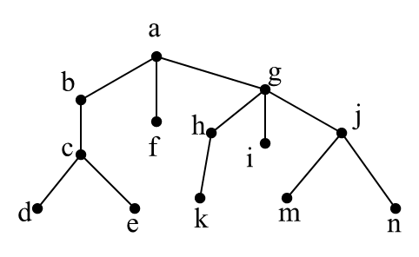
Definitions and terms
A rooted tree is a tree in which one vertex has been designated as the root and every edge is directed away from the root.
If v is a vertex in a tree other than the root, the parent of v is the unique vertex u such that there is a directed edge from u to v.
When u is the parent of v, v is called a child of u.
Vertices with the same parent are called siblings.
Example of a rooted tree with vertex a is the root:

Slide 6
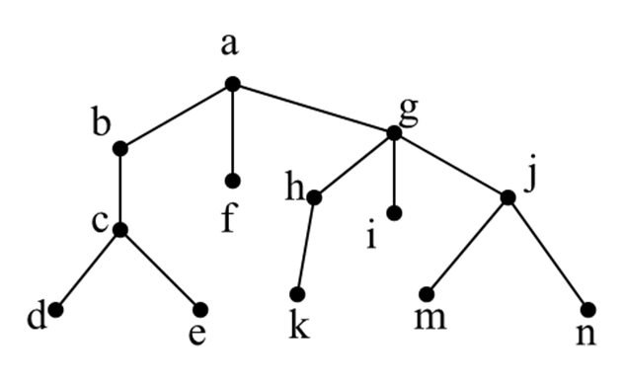
Definitions and terms
The ancestors of a vertex are the vertices in the path from the root to this vertex.
The descendants of a vertex v are those vertices that have v as an ancestor.
A vertex of a tree is called a leaf if it has no children.
If x is a vertex in a tree, the sub-tree with x as its root is the sub-graph of the tree consisting of x and its descendants and all edges incident to these descendants
The height of a tree is the maximum of the lengths of simple paths from the root to the leaves.

Slide 7
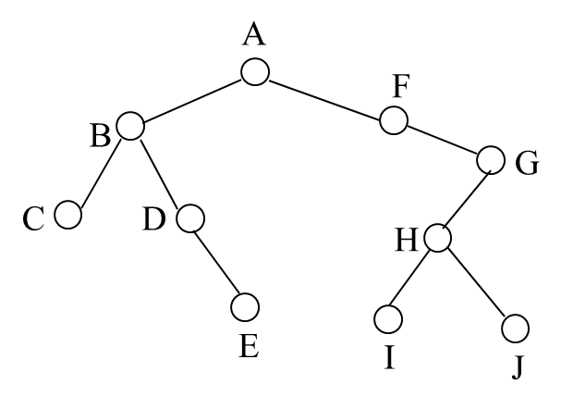
Binary tree
A binary tree is a tree, where every node has at most two children.
One drawn to the left, called the left child, another drawn to the right, called the right child.
Every node in a binary tree is the root of at most two sub-trees, namely, its left sub-tree, and the right sub-tree.

Slide 8
Tree traversal
Visiting a node in a tree generally means retrieving the data item contained in the node, and sending it to some processes such as, printing.
There are three ways in which one could traverse all the nodes in a tree.
Pre-order traversal
In-order traversal
Post-order traversal

Slide 9

Pre-order traversal
Visit the current node.
Traverse the left sub-tree of the current node.
Traverse the right sub-tree of the current node.

Slide 10

In-order traversal
Traverse the left sub-tree of the current node.
Visit the current node.
Traverse the right sub-tree of the current node.

Slide 11
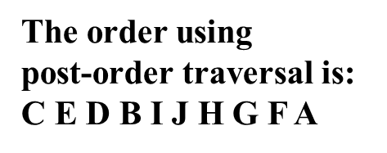
Post-order traversal
Traverse the left sub-tree of the current node.
Traverse the right sub-tree of the current node.
Visit the current node.

Slide 12
Spanning tree
A spanning tree of a graph G = (V, E), is a subgraph of G that is a tree containing every vertex of G.
Given a graph:
Examples of spanning trees:
Examples of subgraphs that are not spanning tree

Slide 13
Spanning tree
Theorem:
Any connected graph G contains a spanning tree.
We can proof this theorem by induction on the number of edges (for info)
Inductive Base: If G₁ has one edge, then the edge with its endpoints is a spanning tree of G₁
Inductive Hypothesis: Assume that any connected graph with number of edges <= k, G_{k} , has a spanning tree.
Inductive Step: We need to prove that we can find a spanning tree for any connected graph with k+1 edges, G_{k+1}.
If G_{k+1} has no circuit, then G_{k+1} is a spanning tree itself.
If G_{k+1} has a circuit C, we can remove any edge e from C and G_{k+1} – {e} is still connected. Since G_{k+1} – {e} has one edge less, it contains a spanning tree T by induction, where T is also a spanning tree for G_{k+1}.

Slide 14
Finding a spanning tree from a graph
Depth-first search (DFS) and breadth-first search (BFS) can be used to find a spanning tree of a graph or to search a tree for a particular data.
For DFS we start by selecting any vertex V₀, and add it to a stack S. It is a Last In First Out (LIFO) process. A helpful analogy is to think of a stack of books; you can remove only the top book, also you can add a new book on the top.
For BFS we start by selecting any vertex V₀, and add it to a queue Q. It is a First In First Out (FIFO) process. An excellent example of a queue is a line of customer in front of a bank counter. New additions to a line are made to the back of the queue, while removal (or serving a queue) happens at the front of a queue.
BFS and DFS are widely used in games design, such as in tic-tac-toe and chess games.

Slide 15
Depth-first search (DFS)
The basic idea of depth-first search is to go as deeply as possible into a path before reaching out to other vertices.
To find a spanning tree by DFS of a graph, start by selecting any vertex V₀, and add it to a stack S.
The stack is processed as follows:
If vertex V is at the top of the stack S, we find its neighbours (that haven't been discovered before) and add them to the stack.
A vertex at the top of the stack is removed from the stack if all of its neighbours have been discovered and added to the stack.

Slide 16
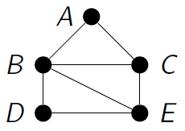
Depth-first search (DFS)
Example:
Use DFS to find a spanning tree for this graph. Assume vertex C is the root and the selection of neighbouring vertex in each iteration is based on the vertex with lowest alphabetical order.
Solution:
Try to draw the tree and see.
Step | 1 | 2 | 3 | 4 | 5 | 6 | 7 | 8 | 9 | 10
S
T

Slide 17
Breadth-first search (BFS)
The basic idea of breadth-first search is to reach out to as many vertices as possible before penetrating deep into the next level.
To find a spanning tree by BFS of a graph, start by selecting any vertex V₀, and add it to a queue Q.
The queue is processed as follows:
If vertex V is at the front of the queue Q, we find its neighbours (that haven't been discovered before) and add them to the queue.
A vertex at the front of the queue is removed from the queue if all of its neighbours have been discovered and added to the queue.

Slide 18
Breadth-first search (BFS)
Example:
Use BFS to find a spanning tree for this graph. Assume vertex D is the root and the selection of neighbouring vertex in each iteration is based on the vertex with lowest alphabetical order.
Solution:
Try to draw the tree and see.
Step | 1 | 2 | 3 | 4 | 5 | 6 | 7 | 8 | 9 | 10
Q
T

Slide 19
Summary
Materials covered in this lecture:
Introduction to tree and its related terms, binary tree, spanning tree.
Tree traversal.
Apply BFS and DFS to find a spanning tree from a graph.

Slide 20
Exercise 1
Given a graph G = (V, E) where V = {0, 2, 4, 6, 8, 10} and
E = {xy|x not equals to y, x divides y or y divides x}.
Is G a tree? Explain your answer.

Slide 21
Exercise 2
Find the spanning tree from the following graph by using
1) DFS
2) BFS
Assume D is the root and the selection of neighbouring vertex in each iteration is based on the vertex with lowest alphabetical order.
A
F
C
B
D
E
G

